Slide 1


TRAVELI

Slide 2
The Vision
The Covid -19 brought us many kinds of problems, one of the problems was that people were stuck in their homes for a long time without the possibility to go out or travel. After the lockdown ended, some of the countries we know and are used to traveling in were closed to tourists. We wanted to cater to those who wanted to escape a little, clear their heads and have a vacation that suits them best with all their favorite attractions. And hence Traveli was born. With the main idea of opening the minds of people to a new places around the world and a new and different process to schedule a holiday.

Slide 3
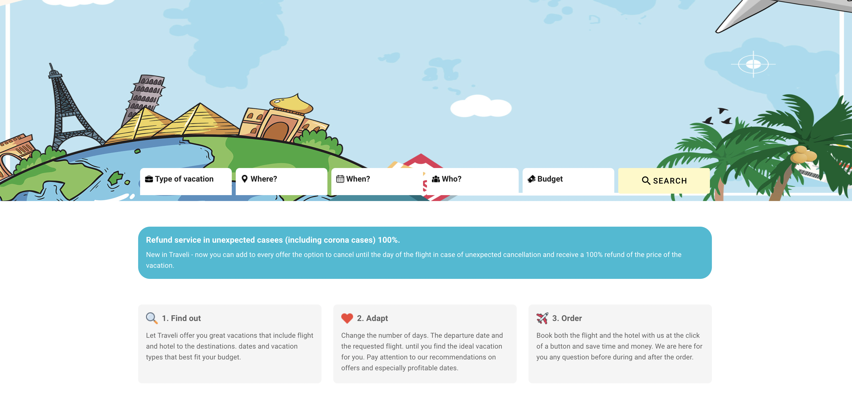
The product
Web – application, which gives the user the option to choose between varius of different preferences regarding the purpose of the vacation and leads you to discover places you didn't think about or knew.
Morover, you have all the details require to make the vacation easy in Covid -19 wise.

Slide 4
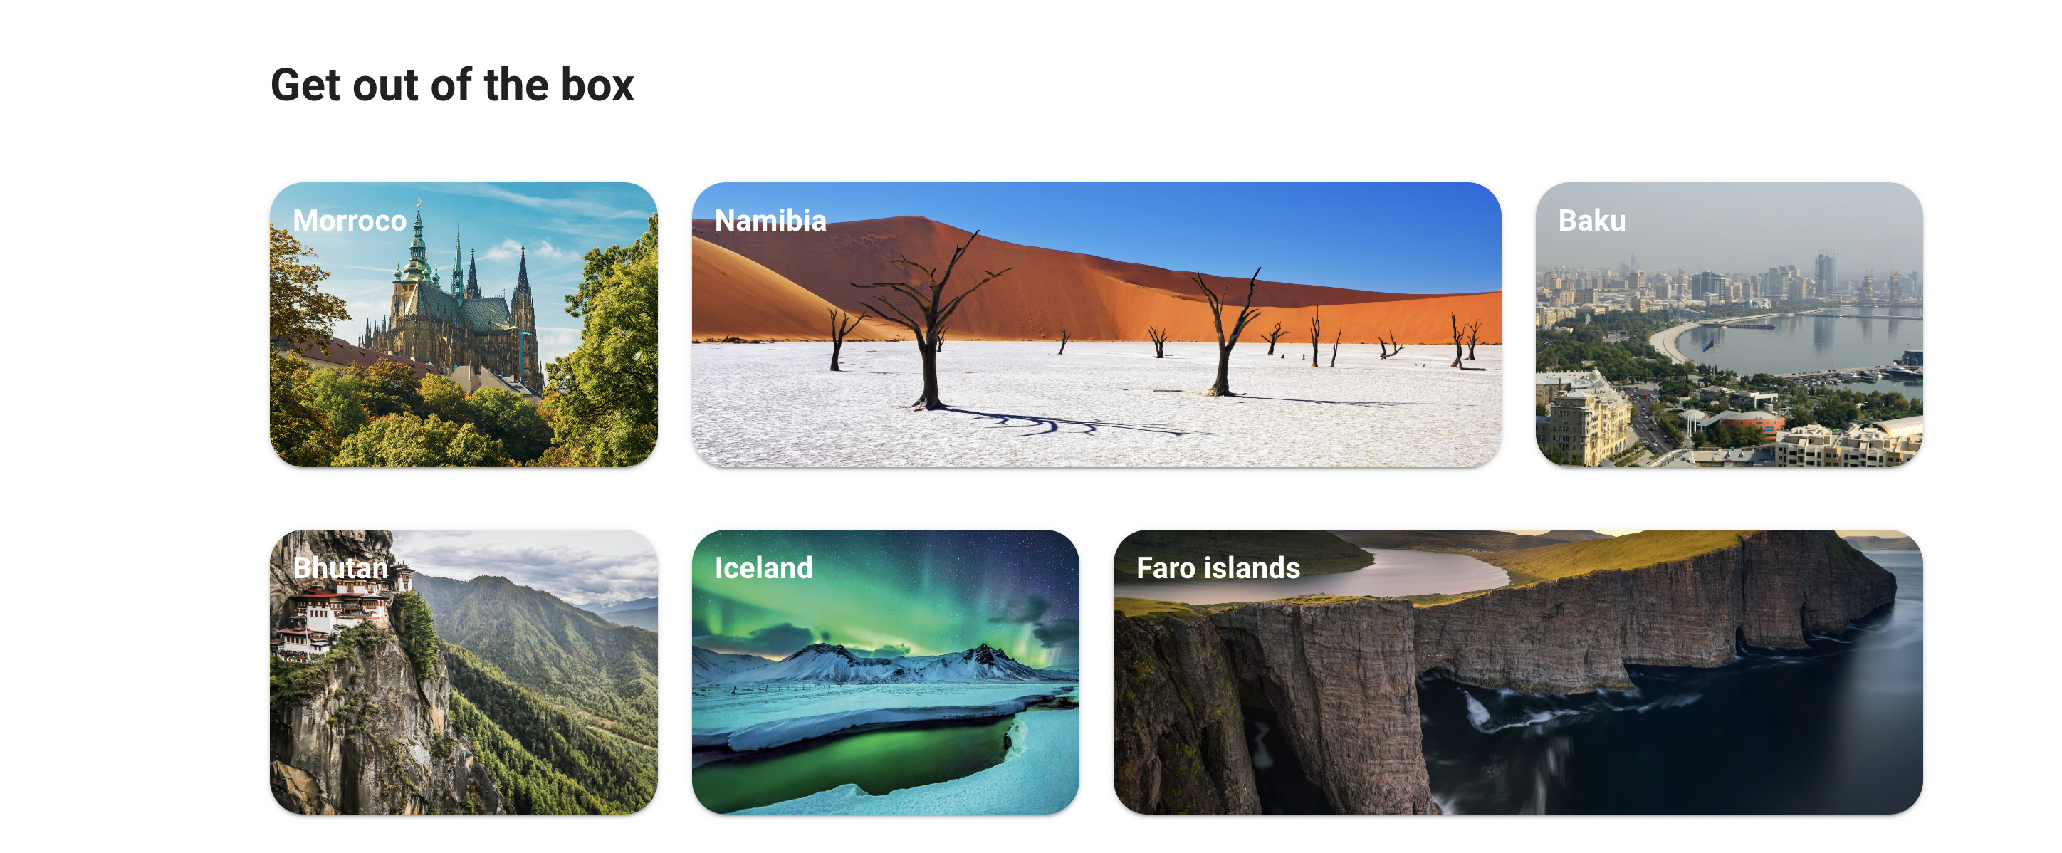
Let Traveli recommend you places you didn't think of, get out of the box and discover new and special places around the world

Slide 5
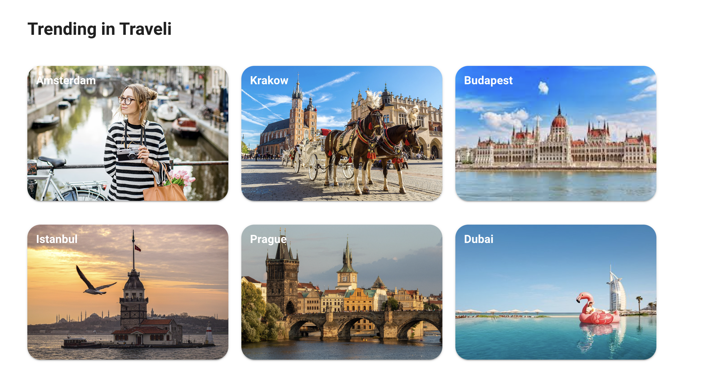
The most popular destinations for the people around you

Slide 6
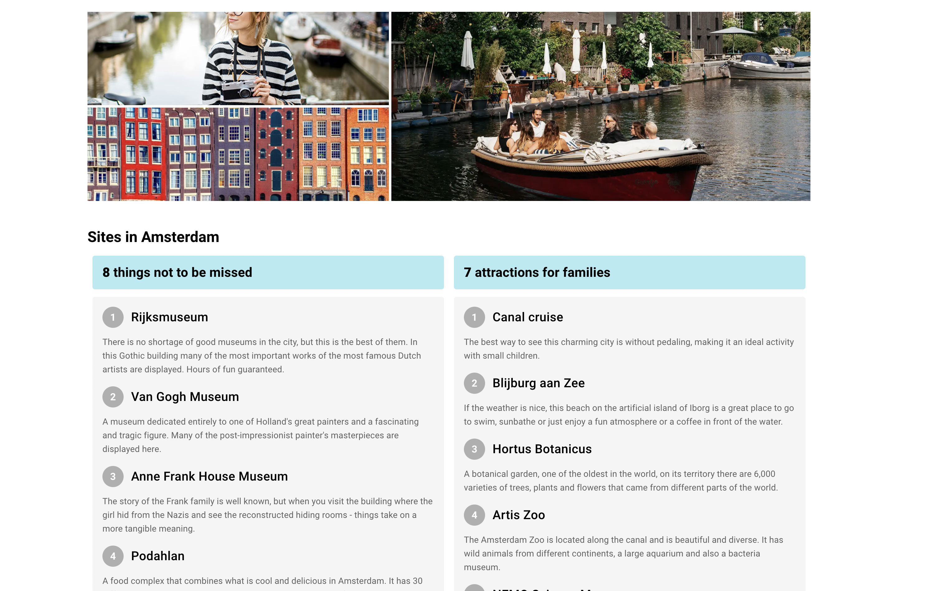
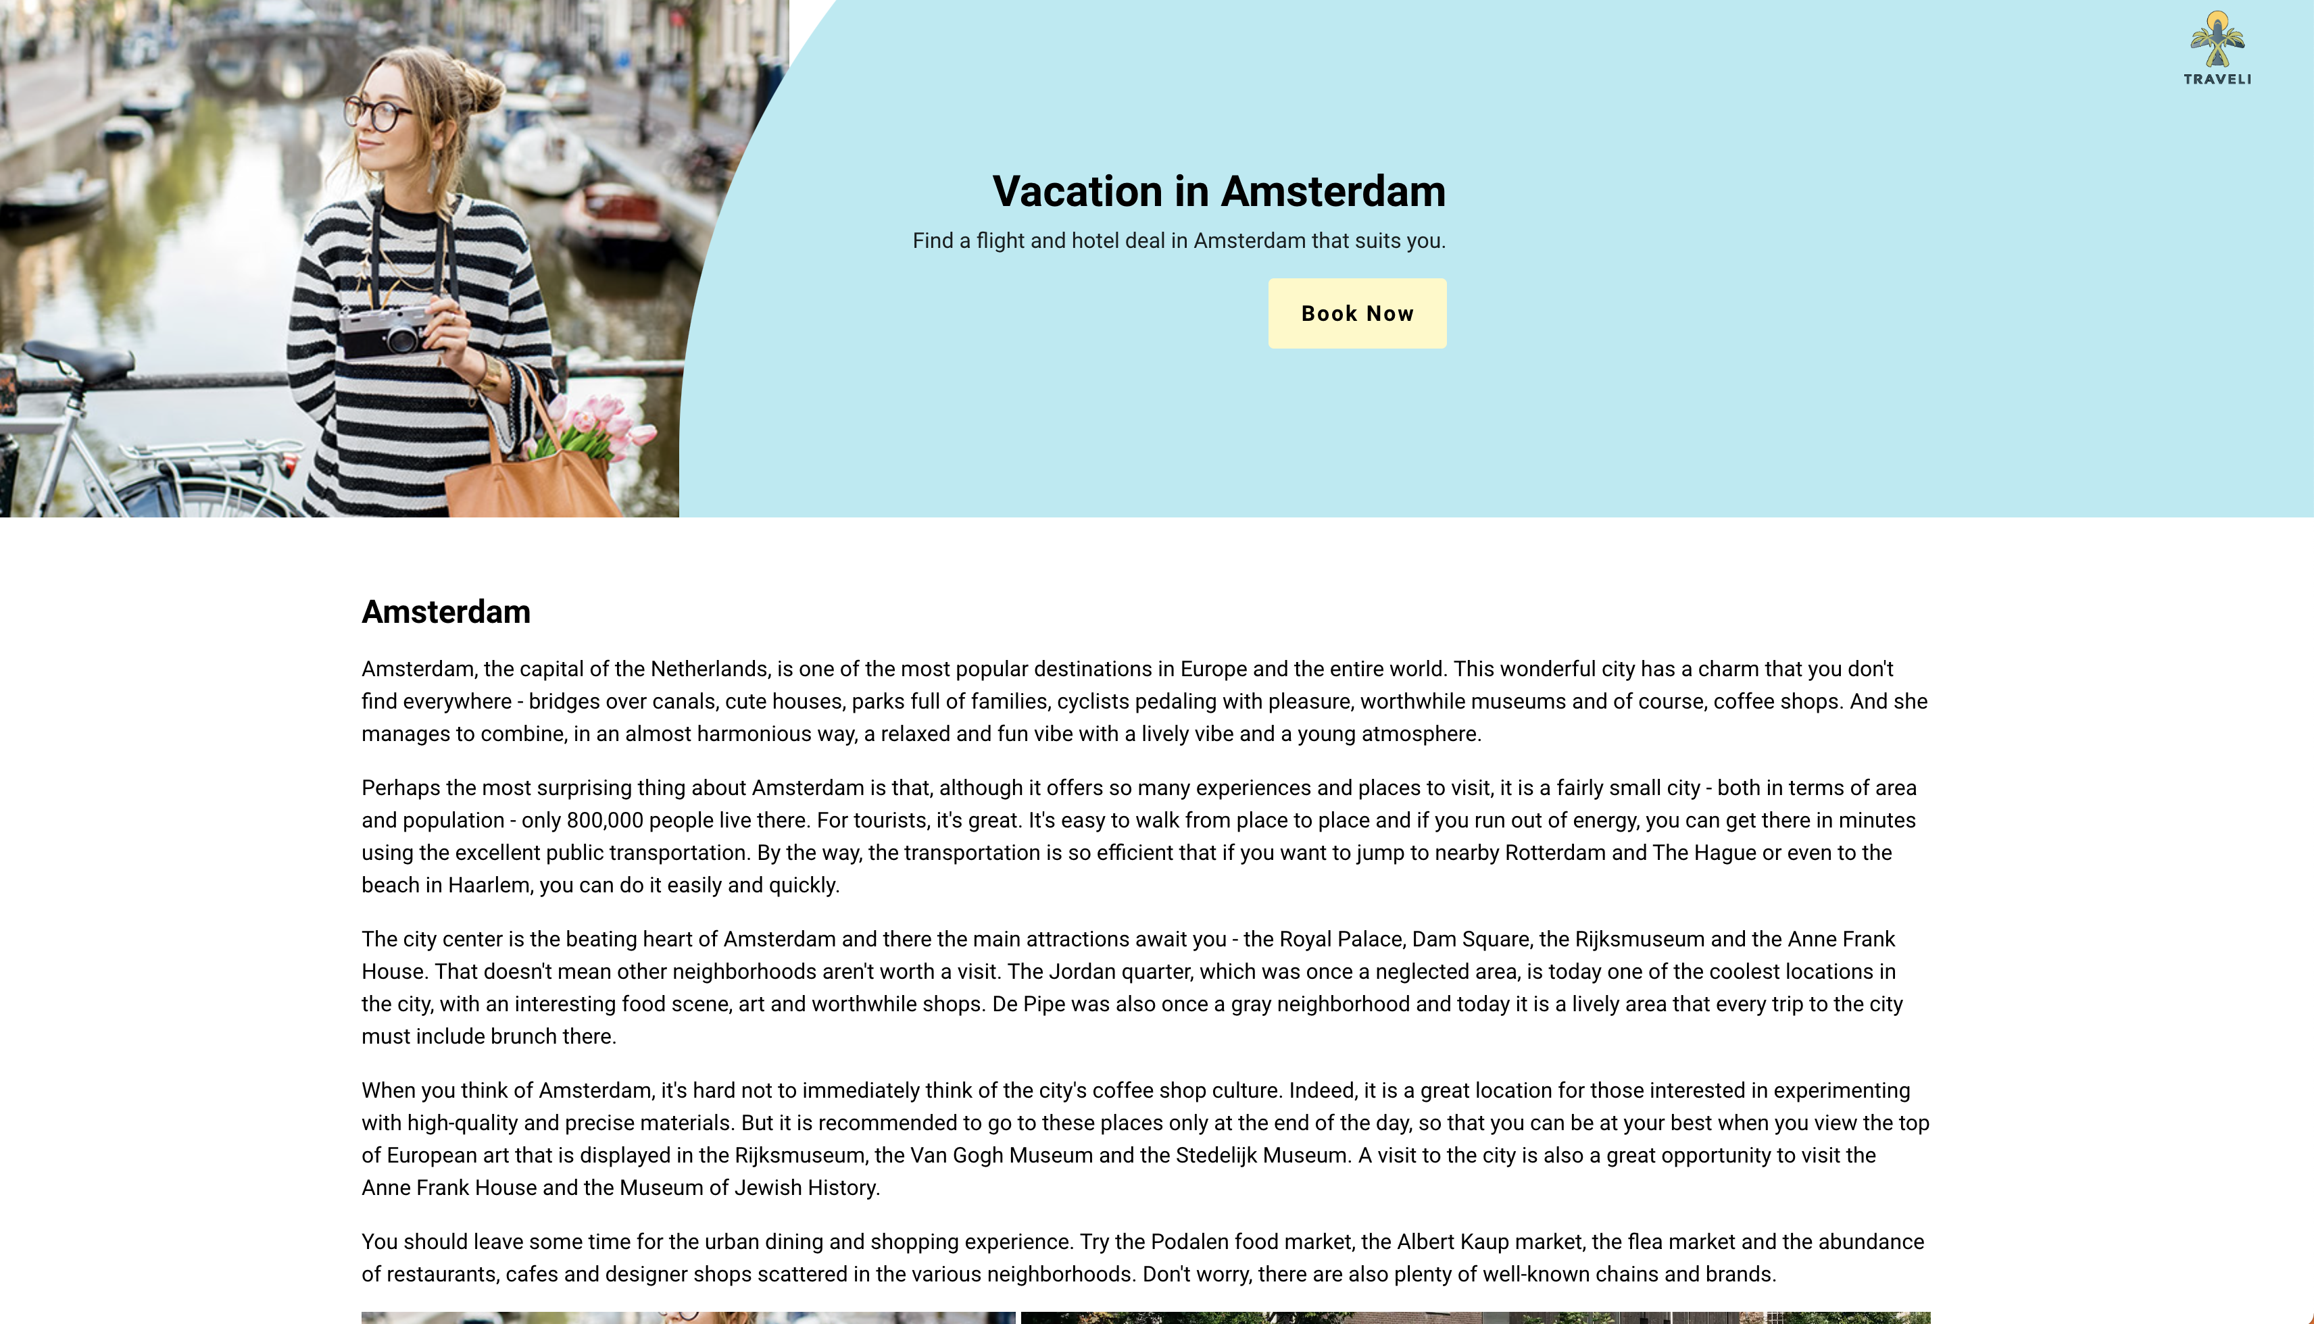
In Traeli you will find all the information you need regurding to your special vacation and the option to book flights, hotels and attractions for your special location.

Slide 7





Technology

Slide 8
Presents
Shawn sagiv – 204816631
Guy Hassin - 312253255
Ayelet Ackerman – 205705452
Link to GitHub repository: https://github.com/ShawnSagiv/Traveli

